Slide 1


Write LESS CSS and make it SASSier
Jake Adams
Thompson Coburn LLP

Slide 2














































Platinum Sponsors
Gold Sponsors
Silver Sponsors

Slide 3
About Me
Jake Adams
Senior Programmer Analyst
Thompson Coburn LLP
email: jacobladams@gmail.com
twitter: @jacobladams
geekswithblogs.com/jacobladams
github.com/jacobladams

Slide 4
Overview
What?
Why?
SASS and LESS Setup
Features
Advanced Features

Slide 5
What are SASS and LESS?
“CSS extension”
“CSS preprocessors”
“Higher-level CSS languages”
“CSS frameworks”

Slide 6

What are SASS and LESS?
SASS
CSS
$blue: #3bbfce;
$margin: 16px;
.content-navigation {
border-color: $blue;
color:
darken($blue, 9%);
}
.border {
padding: $margin / 2;
margin: $margin / 2;
border-color: $blue;
}
.content-navigation {
border-color: #3bbfce;
color: #2b9eab;
}
.border {
padding: 8px;
margin: 8px;
border-color: #3bbfce;
}

Slide 7
Why?
DRY Principle
D on’t
R epeat
Y ourself

Slide 8
Don’t Repeat Yourself
public Stats GetStatsDatabase()
{
Stats stats = new Stats();
using (SqlConnection conn = new SqlConnection("Data Source=mySvr;Initial Catalog=myDB;User ID=jake;Password=pass"))
{
using (SqlCommand command = new SqlCommand("GetNumberOfAccounts", conn))
{
command.CommandType = CommandType.StoredProcedure;
conn.Open();
stats.NumberOfAccounts = (int)command.ExecuteScalar();
}
}
using (SqlConnection conn = new SqlConnection("Data Source=mySvr;Initial Catalog=myDB;User ID=jake;Password=pass"))
{
using (SqlCommand command = new SqlCommand("GetNumberOfClients", conn))
{
command.CommandType = CommandType.StoredProcedure;
conn.Open();
stats.NumberOfClients = (int)command.ExecuteScalar();
}
}
return stats;
}

Slide 9
Don’t Repeat Yourself
private string _connectionString = "Data Source=mySvr;Initial Catalog=myDB;User ID=jake;Password=password";
public Stats GetStatsDatabase()
{
Stats stats = new Stats();
stats.NumberOfAccounts = (int)GetDataFromStoredProcedure("GetNumberOfAccounts");
stats.NumberOfClients = (int)GetDataFromStoredProcedure("GetNumberOfClients");
return stats;
}
private object GetDataFromStoredProcedure(string storedProcedure)
{
using (SqlConnection conn = new SqlConnection(_connectionString))
{
using (SqlCommand command = new SqlCommand(storedProcedure, conn))
{
command.CommandType = CommandType.StoredProcedure;
conn.Open();
return command.ExecuteScalar();
}
}
}

Slide 10
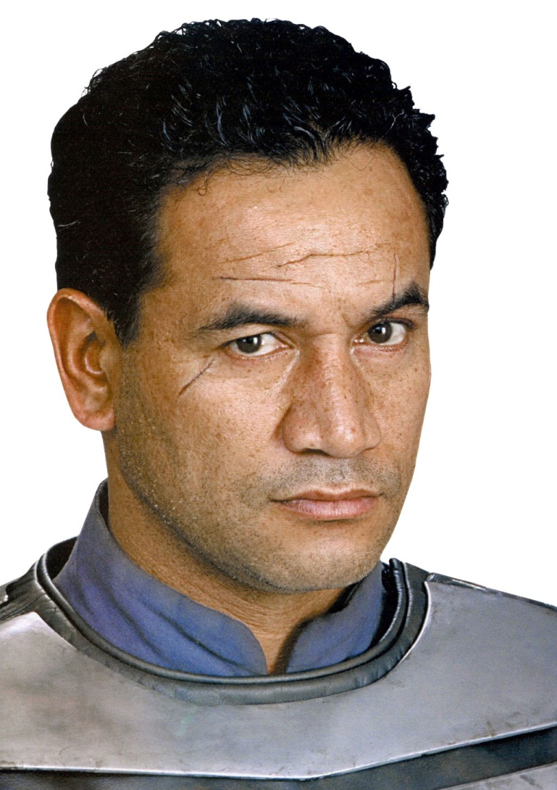
Don’t Repeat Yourself
Reduce Typing
Improve Maintainability
Reduce Errors
Improve readability
Jango Fett – repeated himself

Slide 11

Make the machines work for you, not vice versa…
Neo – doesn’t do copy/paste programming

Slide 12
HOW? – SETUP

Slide 13
How?
Install Tools
Usage
1) Command line - one time compile
2) Command line - watch file/folder
3) Dynamic compile/Plugin

Slide 14


Install SASS
SASS in written in Ruby
1) Install Ruby via Ruby Windows Installer
2) From command line
gem.bat install sass
1) Install IronRuby
2) From command line (as administrator)
igem.bat install sass

Slide 15
SASS Command Line Usage
One time compile
sass myStyleSheet.scss myStyleSheet.css
Watch file
sass --watch myStyleSheet.scss:myStyleSheet.css
Watch directory of Sass files
sass --watch app/sass:public/stylesheets

Slide 16
SassAndCoffee
.NET Library for ASP.NET and ASP.NET MVC which will automatically convert SASS and CoffeeScript files as they are requested.
Installation/Usage
1) Install SassAndCoffee NuGet package
2) Add link to compiled css file name
<link href="@Url.Content("~/Content/myStyleSheet.css")" rel="stylesheet" type="text/css" />
3) HTTP request for CSS file will be intercepted, the SASS file will be compiled and the output returned to the client

Slide 17

LESS
LESS is primarily written in JavaScript
1) Download less.js and include it along with .less file in HTML
2) JavaScript will run when page is accessed and .less will be compiled and applied at runtime.
<link rel="stylesheet/less" type="text/css" href="myStyleSheet.less">
<script src="less.js" type="text/javascript"></script>

Slide 18

LESS
1) Install node.js for windows
2) From command line
npm install less -g
Command line usage
lessc myStyleSheet.less myStyleSheet.css

Slide 19

LESS
1) Download dotless
Command line - one time compile
dotless.Compiler.exe myStyleSheet.less [myStyleSheet.css]
Command line - watch file
dotless.Compiler.exe --watch myStyleSheet.less [myStyleSheet.css]

Slide 20
LESS
NuGet Package
1) Install dotless NuGet package
2) Add link to .less file
<link href="@Url.Content("~/Content/myStyleSheet.less")" rel="stylesheet" />
3) HTTP request for .less file will be handled by the LESS compiler and a compiled CSS file will be returned to the client

Slide 21


Slide 22
LESS –VS2012 RC
Uses bundling in ASP.NET 4.5
NuGet Package
1) Install BundleTransformer.Less NuGet package (include prelease packages)
2) Modify BundleConfig .cs in App_Start
var siteStyleBundle = new StyleBundle("~/Content/less")
siteStyleBundle.IncludeDirectory("~/Content/", "*.less");
siteStyleBundle.Transforms.Add(new
BundleTransformer.Core.Transformers.CssTransformer());
bundles.Add(siteStyleBundle);

Slide 23
Precompile vs. Dynamic
Precompile
Dynamic Compilation
Easier to deploy
Faster runtime performance
Quicker to get started
Easier Maintenance

Slide 24
Features

Slide 25
Variables
SASS
CSS
$pageWidth: 630px;
$headerHeight: 387px;
$mainGray: #999999;
$border: 0px dotted $mainGray;
$bgRepeat: no-repeat;
#container {
width: $pageWidth;
margin: auto;
background:url(rounded.jpg) $bgRepeat;
border: $border;
position: relative;
}
#pageHeader {
background: url(header.jpg) $bgRepeat;
border: $border;
width: $pageWidth;
height: $headerHeight;
}
#container {
width: 630px;
margin: auto;
background: url(rounded.jpg) no-repeat;
border: 0px dotted #999999;
position: relative; }
#pageHeader {
background: url(header.jpg) no-repeat;
border: 0px dotted #999999;
width: 630px;
height: 387px; }

Slide 26
Variables
SASS
LESS
$pageWidth: 630px;
$headerHeight: 387px;
$mainGray: #999999;
$border: 0px dotted $mainGray;
$bgRepeat: no-repeat;
#container {
width: $pageWidth;
margin: auto;
background:url(rounded.jpg) $bgRepeat;
border: $border;
position: relative;
}
#pageHeader {
background: url(header.jpg) $bgRepeat;
border: $border;
width: $pageWidth;
height: $headerHeight;
}
@pageWidth: 630px;
@headerHeight: 387px;
@mainGray: #999999;
@border: 0px dotted @mainGray;
@bgRepeat: no-repeat;
#container {
width: @pageWidth;
margin: auto;
background:url(rounded.jpg) @bgRepeat;
border: @border;
position: relative;
}
#pageHeader {
background: url(header.jpg) @bgRepeat;
border: @border;
width: @pageWidth;
height: @headerHeight;
}

Slide 27

Variable Scoping
SASS
LESS
$color: #000000;
.scoped {
$color: #ffffff;
color: $color;
}
.unscoped {
color: $color;
}
.scoped {
color: #ffffff; }
.unscoped {
color: #ffffff; }
@color: #000000;
.scoped {
@color: #ffffff;
color: @color;
}
.unscoped {
color: @color;
}
.scoped {
color: #ffffff;}
.unscoped {
color: #000000;}

Slide 28
Mixins
LESS
CSS
.annoyingFont{
font: bold 20px 'Comic Sans MS';
text-transform:uppercase;
text-decoration:underline
}
#footer{
.annoyingFont;
text-align:left;
padding:0 0 0 0;
margin:0 0 0 60px;
}
#pageHeader{
.annoyingFont;
width:630px;
height:387px;
}
.annoyingFont {
font: bold 20px 'Comic Sans MS';
text-transform: uppercase;
text-decoration: underline;
}
#footer {
font: bold 20px 'Comic Sans MS';
text-transform: uppercase;
text-decoration: underline;
text-align: left;
padding: 0 0 0 0;
margin: 0 0 0 60px;
}
#pageHeader {
font: bold 20px 'Comic Sans MS';
text-transform: uppercase;
text-decoration: underline;
width: 630px;
height: 387px;
}

Slide 29
Mixins
SASS
CSS
@mixin annoyingFont{
font: bold 20px 'Comic Sans MS';
text-transform:uppercase;
text-decoration:underline
}
#footer{
@include annoyingFont;
text-align:left;
padding:0 0 0 0;
margin:0 0 0 60px;
}
#pageHeader{
@include annoyingFont;
width:630px;
height:387px;
}
#footer {
font: bold 20px 'Comic Sans MS';
text-transform: uppercase;
text-decoration: underline;
text-align: left;
padding: 0 0 0 0;
margin: 0 0 0 60px;
}
#pageHeader {
font: bold 20px 'Comic Sans MS';
text-transform: uppercase;
text-decoration: underline;
width: 630px;
height: 387px;
}

Slide 30
CSS3 Vendor Prefixes
Prefix | Organization
-ms- | Microsoft
-webkit- | Apple, Google
-moz- | Mozilla
-o- -xv- | Opera
Example:
roundedCorners{
-moz-border-radius: 5px;
-webkit-border-radius: 5px;
border-radius: 5px;
}

Slide 31
Mixins and Vendor Prefixes
CSS
SASS
.page {
-moz-border-radius: 5px;
-webkit-border-radius: 5px;
border-radius: 5px;
background: #999999;
}
@mixin roundedCorners{
-moz-border-radius: 5px;
-webkit-border-radius: 5px;
border-radius: 5px;
}
.page {
@include roundedCorners;
background: #999999;
}

Slide 32
Parametric Mixins
SASS
CSS
@mixin roundedCorners($radius: 10px){
-moz-border-radius: $radius;
-webkit-border-radius: $radius;
border-radius: $radius;
}
.page {
@include roundedCorners(5px);
background: #999999;
}
.page {
-moz-border-radius: 5px;
-webkit-border-radius: 5px;
border-radius: 5px;
background: #999999;
}

Slide 33
LESS Mixins without Replication
LESS
CSS
.annoyingFont(){
font: bold 20px 'Comic Sans MS';
text-transform:uppercase;
text-decoration:underline
}
#footer{
.annoyingFont;
text-align:left;
padding:0 0 0 0;
margin:0 0 0 60px;
}
#pageHeader{
.annoyingFont;
width:630px;
height:387px;
}
#footer {
font: bold 20px 'Comic Sans MS';
text-transform: uppercase;
text-decoration: underline;
text-align: left;
padding: 0 0 0 0;
margin: 0 0 0 60px;
}
#pageHeader {
font: bold 20px 'Comic Sans MS';
text-transform: uppercase;
text-decoration: underline;
width: 630px;
height: 387px;
}

Slide 34
SASS Selector Inheritance
SASS
CSS
.annoyingFont{
font: bold 20px 'Comic Sans MS';
text-transform:uppercase;
text-decoration:underline
}
#footer{
@extend .annoyingFont;
text-align:left;
padding:0 0 0 0;
margin:0 0 0 60px;
}
#pageHeader{
@extend .annoyingFont;
width:630px;
height:387px;
}
.annoyingFont, #footer, #pageHeader {
font: bold 20px 'Comic Sans MS';
text-transform: uppercase;
text-decoration: underline;
}
#footer {
text-align: left;
padding: 0 0 0 0;
margin: 0 0 0 60px;
}
#pageHeader {
width: 630px;
height: 387px;
}

Slide 35
Imports - LESS
LESS
CSS
//a.less
@import "b.less";
@width: 960px;
.content{
width: @width;
}
//b.less
@width: 640px;
.page{
width: @width;
}
//a.css
.page {
width: 960px;
}
.content {
width: 960px;
}

Slide 36
Imports - LESS
LESS
CSS
//a.less
@import "b.css";
@width: 960px;
.content{
width: @width;
}
//b.less
@width: 640px;
.page{
width: @width;
}
//a.css
@import "b.css";
.content {
width: 960px;
}
//b.css
.page {
width: 640px;
}

Slide 37
Imports - SASS
SASS
CSS
//a.scss
@import "b.scss";
$width: 960px;
.content{
width: $width;
}
//b.scss
$width: 640px;
.page{
width: $width;
}
//a.css
.page {
width: 640px;
}
.content {
width : 960px;
}

Slide 38
Imports - SASS
SASS
CSS
//a.scss
@import "b.css";
$width: 960px;
.content{
width: $width;
}
//b.scss
$width: 640px;
.page{
width: $width;
}
//a.css
@import url(b.css);
.content {
width: 960px;
}
//b.css
.page {
width: 640px;
}

Slide 39

BREAK TIME!

Slide 40
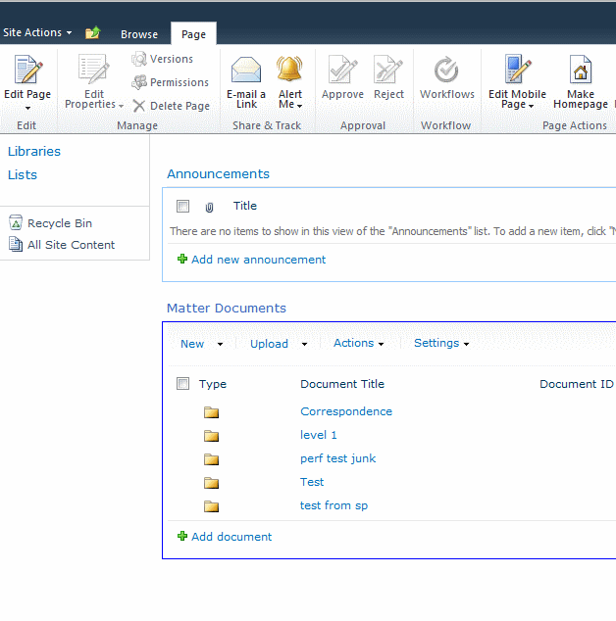
Guess the Mess
The core.css file is the main CSS file for SharePoint.
Reply to me on twitter (@jacobladams) your guess for how many total lines in core.css you have to change:
all the fonts from Verdana
primary text color from #6f9dd9

Slide 41
Nesting
CSS
SASS/LESS
#linkList {
position: absolute;
left:160px;
right:auto;
padding:0 0 0 0;
border:0px dotted #666666;
}
#linkList ul {
text-align: left;
list-style: none;
margin: 0 0 0 0;
padding:0 0 15px 35px;
border:0px dotted #666666;
width:120px;
}
#linkList ul li{
margin: 0;
padding: 3px 0 3px 0;
border-bottom: 1px dotted #999999;
}
#linkList ul li a{
border-bottom: none;
}
#linkList {
position: absolute;
left:160px;
right:auto;
padding:0 0 0 0;
border:0px dotted #666666;
ul {
text-align: left;
list-style: none;
margin: 0 0 0 0;
padding:0 0 15px 35px;
border:0px dotted #666666;
width:120px;
li{
margin: 0;
padding: 3px 0 3px 0;
border-bottom: 1px dotted #999999;
a{
border-bottom: none;
}
}
}
}

Slide 42
SASS – Parent References
SASS
CSS
$main-color: #ce4dd6;
$style: solid;
li a {
color: $main-color;
&:hover { border-bottom: $style 1px; }
}
li a {
color: #ce4dd6;
}
li a:hover {
border-bottom: solid 1px;
}

Slide 43
SASS Nested Properties
SASS
CSS
@mixin annoyingFont{
font: {
family: 'Comic Sans MS';
size: 20px;
weight: bold;
}
text-transform:uppercase;
text-decoration:underline
}
.content {
@include annoyingFont
}
.content {
font-family: 'Comic Sans MS';
font-size: 20px;
font-weight: bold;
text-transform: uppercase;
text-decoration: underline;
}

Slide 44

Operations
SASS
CSS
$containerWidth: 960px;
$pageWidth: $containerWidth *2/3;
#container{
width:$containerWidth;
}
#page{
width:$pageWidth;
}
#sidebar{
width:$containerWidth - $pageWidth;
}
#container {
width: 960px;
}
#page {
width: 640px;
}
#sidebar {
width: 320px;
}

Slide 45
Functions - Common
RGB Color Functions
rgb
rgba
mix
Math Functions
percentage
round
ceil
floor
abs
HSL Color Functions
hsl
hsla
hue
saturation
lightness
alpha
lighten
darken
saturate
desaturate
grayscale/greyscale
fadein/fade-in/opacify
faseout/fade-out/transparentize

Slide 46
Function – Unique
SASS*
LESS*
adjust-color
scale-color
change-color
unquote
quote
length
nth
join
append
type-of
unit
unitless
comparable
complement
red
green
blue
e
escape
_math
color
number
isPixel
isPercentage
IsString
isNumber
isColor
isEm
_isa
clamp
*dotless supports most of these

Slide 47
Comments
Supports standard CSS block comments
/*
Standard CSS block comments
work as expected
*/
Also supports “silent” single line comments
// Single line comments.
// These will be excluded from the generated CSS

Slide 48
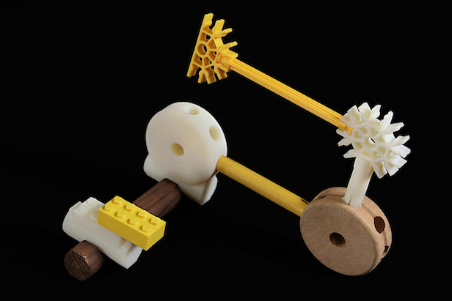
Extensibility

Slide 49
SASS – Custom Functions
#customFunction.rb
module Sass::Script::Functions
def split_complement1(color)
adjust_hue color, Sass::Script::Number.new(150)
end
def split_complement2(color)
adjust_hue color, Sass::Script::Number.new(210)
end
end
//custom.scss
body{
background-color: split_complement1(#ff0000);
}
.content{
background-color: split_complement2(#ff0000);
}
Command Line Usage
Sass custom.scss custom.css –r customFunction.rb

Slide 50
SASS – Custom Functions
//custom.scss
@function split_complement1($color){
@return adjust_hue($color, 150)
}
@function split_complement2($color){
@return adjust_hue($color, 210)
}
body{
background-color: split_complement1(#ff0000);
}
.content{
background-color: split_complement2(#ff0000);
}

Slide 51
LESS – Custom Functions
Not supported directly
Edit the functions.js file
(in AppData\Roaming\npm\node_modules\less\lib\less)
tree.functions = {
...
split_complement1: function(color) {
return this.spin(color, new (tree.Dimension)(150));
},
split_complement2: function(color) {
return this.spin(color, new (tree.Dimension)(210));
}
};

Slide 52
dotless – Plugins
Add reference to dotless.core.dll
Write plugin code
Put plugin in \plugins directory
[DisplayName("Split Complements"), Description("Creates Split Complements. Duh")]
public class SplitComplementsPlugin : IFunctionPlugin
{
public Dictionary<string, Type> GetFunctions()
{
return new Dictionary<string, Type> { {"split_complement1", typeof(SplitComplement1Function)}};
}
}
public class SplitComplement1Function : Function
{
protected override Node Evaluate(Env env)
{
var arguments = new List<Node> { this.Arguments[0] as Color, new Number(150) };
return new SpinFunction().Call(env, arguments);
}
}
Command Line Usage
dotless.Compiler.exe custom.less custom.css –p SplitComplementsPlugin

Slide 53

Bonus Material / Advanced features

Slide 54
SASS Indented Syntax
.SCSS
.SASS
ul {
text-align: left;
list-style: none;
margin: 0 0 0 0;
padding: 0 0 15px 35px;
border: 0px dotted #666666;
width: 120px;
li{
margin: 0;
padding: 3px 0 3px 0;
a{
border-bottom: none;
}
}
}
ul
text-align: left
list-style: none
margin: 0 0 0 0
padding: 0 0 15px 35px
border: 0px dotted #666666
width: 120px
li
margin: 0
padding: 3px 0 3px 0
a
border-bottom: none

Slide 55
SASS Indented Syntax
Uses indentation instead of { and } for blocks
No semicolons
Has .sass extension instead of .scss
Inspired by HAML

Slide 56
String Interpolation
SASS
$extra: "italic bold";
.content{
font: "#{$extra} 12px arial,sans-serif"
}
LESS
@extra: "italic bold";
.content{
font: "@{extra} 12px arial,sans-serif"
}
CSS
.content {
font: "italic bold 12px arial,sans-serif";
}

Slide 57
SASS Selector and Properties
SASS
CSS
$direction: top;
$selector: nav;
.#{$selector} li {
margin-#{direction}: 5px;
}
.nav li {
margin-top: 5px;
}

Slide 58
LESS -Arguments Parameter
LESS
CSS
.box-shadow (@x: 0, @y: 0, @blur: 1px, @color: #000) {
box-shadow: @arguments;
-moz-box-shadow: @arguments;
-webkit-box-shadow: @arguments;
}
.header{
.box-shadow(2px, 5px);
}
.footer{
.box-shadow(2px, 5px, 1px, #000);
}
.header {
box-shadow: 2px 5px 1px #000000;
-moz-box-shadow: 2px 5px 1px #000000;
-webkit-box-shadow: 2px 5px 1px #000000;
}
.footer {
box-shadow: 2px 5px 1px #000000;
-moz-box-shadow: 2px 5px 1px #000000;
-webkit-box-shadow: 2px 5px 1px #000000;
}

Slide 59
LESS Guard Statements
LESS
CSS
.navLink(@numLinks) when (@numLinks =< 3){
font-size:14px;
}
.navLink(@numLinks) when (@numLinks > 3 ) and (@numLinks =< 6){
font-size:12px;
}
.navLink(@numLinks) when (@numLinks > 6){
font-size:10px;
}
.nav li{
.navLink(7);
}
.footer li{
.navLink(4);
}
.nav li {
font-size: 10px;
}
.footer li {
font-size: 12px;
}

Slide 60
LESS Pattern Matching
LESS
CSS
@navBarWidth: 960px;
.navLink(annoying, @numLinks){
font: bold 20px 'Comic Sans MS';
}
.navLink(normal, @numLinks){
font: 12px Georgia;
}
.navLink(@_, @numLinks){
width: @navBarWidth / @numLinks;
}
.nav li{
.navLink(annoying, 6);
}
.footer li{
.navLink(normal, 4);
}
.nav li {
font: bold 20px 'Comic Sans MS';
width: 160px;
}
.footer li {
font: 12px Georgia;
width: 240px;
}

Slide 61
SASS – Control Directives
SASS
CSS
@mixin navLink($numLinks){
@if $numLinks <= 3 {
font-size:14px;
}
@else if $numLinks > 3 and $numLinks <= 6{
font-size:12px;
}
@else if $numLinks > 6 {
font-size:10px;
}
}
.nav li{
@include navLink(7);
}
.footer li{
@include navLink(4);
}
.nav li {
font-size: 10px;
}
.footer li {
font-size: 12px;
}

Slide 62
SASS – Control Directives
SASS
CSS
@for $i from 1 through 3 {
.item-#{$i} {
background-image: url('/images/#{$i}.png');
}
}
.item-1 {
background-image: url("/images/1.png"); }
.item-2 {
background-image: url("/images/2.png"); }
.item-3 {
background-image: url("/images/3.png"); }

Slide 63
Frameworks
SASS
Compass – Provides SASS templates, image spriting, and more
LESS
Twitter Bootstrap – template style, grid system, widgets, and more
Both
Frameless – grid/layout framework

Slide 64
SASS - Command Line Options
--trace
--check
--style nested|compact|compressed|expanded
--debug-info
--line-numbers
--load-path PATH
--require LIB?
--cache-location PATH
--no-cache
--encoding

Slide 65
LESS Command Line Options
--compress
--yui-compress
--verbose
--silent
--no-color
--include-path PATH
--strict-imports

Slide 66
dotLess – Command Line Options
--minify
--keep-first-comment
--debug
--disable-url-rewriting
--import-all-less
--inline-css
--disable-variable-redefines

Slide 67
LESS – JavaScript Eval
LESS
CSS
@nav: `'bl' + 'ue'`;
@height: `Math.PI * 100`;
#nav{
background-color: @nav;
height: @height;
}
#nav {
background-color: "blue";
height: 314.1592653589793;
}

Slide 68
LESS JavaScript watch option
<script type="text/javascript">
less.env = "development";
less.watch();
</script>
“In development mode CSS won’t be cached and the watch mode should auto refresh your CSS when you save your .less file”

Slide 69
LESS - Namespaces
LESS
CSS
.jakesStuff {
.roundedCorners(@radius: 10px){
-moz-border-radius: @radius;
-webkit-border-radius: @radius;
border-radius: @radius;
}
}
.content{
background: #ff0000;
.jakesStuff > .roundedCorners(5px);
}
.content {
background: #ff0000;
-moz-border-radius: 5px;
-webkit-border-radius: 5px;
border-radius: 5px;
}

Slide 70
Questions?

Slide 71
Links
Link Bundle:
bit.ly/sassandless
Includes
The slides for this presentation
Sass
Less
Ruby installer
Iron Ruby installer
SassAndCoffee
Node.js
Dotless
Compass
Twitter bootstrapper
Comparison Articles

Slide 72
If you think of a question later
Jake Adams
Senior Programmer Analyst
Thompson Coburn LLP
email: jacobladams@gmail.com
twitter: @jacobladams
geekswithblogs.com/jacobladams
github.com/jacobladams
Link Bundle: bit.ly/sassandless
Eval : http://stldodn.com/m

